Slide 1
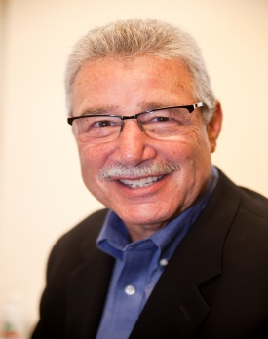
LEARNING LEADERSHIP:
Why It Matters & What It Takes
Ausra Deluard
Jones Day
Barry Posner
Santa Clara University
Symposium: Advancing Leadership Development in the Legal Profession
Santa Clara University
March 23, 2018

Slide 2
The ability to demonstrate leadership has been identified as a core competency of leading law firms.
NALP Foundation
© James M. Kouzes & Barry Z. Posner. All rights reserved.

Slide 3
Leadership education is
important to all lawyers and law students because it provides the skills and abilities necessary for successful engagement in civic responsibilities, for meeting the requirements of client representation, and for managing the responsibilities within a law firm or law organization.
Donald Polden
Santa Clara Law Review

Slide 4
The art of mobilizing others to want to struggle for shared aspirations.
Jim Kouzes and Barry Posner

Slide 5
Challenges &
Opportunities
Training Deficit
Lawyer Personalities
Autonomy Skepticism Sociability Resilience Urgency Abstract Reasoning
Occupational Interests
Enterprising
Social
Artistic

Slide 6
Reshaping What’s Important

Slide 7
The Five Practices of Exemplary Leadership®
1
Model the Way
2
Inspire a Shared Vision
3
Challenge the Process
4
Enable Others to Act
5
Encourage the Heart

Slide 8
Kouzes & Posner’s Research
Over 35 years of collecting data
5,000+ individual cases studied
Over 5 million survey respondents
Global data from 180+ countries
More than 700 research studies by others
Rigorous testing of reliability and validity of model

Slide 9
Key Conceptual Dimensions and Practical Ideas for Leadership
Development

Slide 10
Leadership is a skill (it can be learned, requiring practice and feedback)
Leadership is everyone’s business (process not a position)
Leadership is about serving others (building relationships)
Leadership is focused on the future (doing something better)
Leadership is personal (inner territory)
Leadership is learned through doing

Slide 11
Fundamental Course Components
Based on a model/framework that makes both conceptual and common sense.
Backed by evidence/research.
Is measurable (can be learned).
Developed through practice (doing)
Adaptable and accessible across multiple disciplines, functions, levels, and cultures.

Slide 12
Helping People to Become the Best Leaders They Can Be Requires:
1. Instilling Belief
2. Elevating Aspirations
3. Initiating Challenges
4. Engaging Support
5. Practicing Deliberately

Slide 13
QUESTIONS
Notes:
13

