Slide 1
Law School Leadership and Leadership Development for Developing Lawyers
Louis D. Bilionis
Dean Emeritus and Droege Professor of Law
University of Cincinnati College of Law
Fellow, Holloran Center for Ethical Leadership in the Profession
Symposium: Advancing Leadership Development in the Legal Profession: Addressing Challenges in Legal Education and the Practice of Law
Santa Clara University School of Law
March 23, 2018

Slide 2
leadership and legal education:
the progress that has been made
_____________________
concepts and methods
relevancy and importance of leadership
alternative nomenclatures
models and experimentation
pedagogy – experiences, coaching, and reflection
competencies and learning outcomes
[1]

Slide 3
leadership and legal education:
the progress that has been made
_____________________
people
“coalition of the willing”
leadership cohorts
expanding adoption
[2]

Slide 4
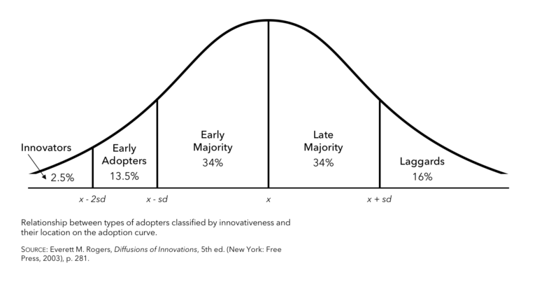
Rogers’ Diffusion of Innovation Curve
[3]

Slide 5
the leadership challenge
_____________________
What might members of the “coalition of the willing” – the “innovators” and “early adopters” – do to influence the prospective “early majority” individuals to adopt?
[4]

Slide 6
what is the “innovation” to be adopted?
_____________________
purposeful institutional support for leadership development
(or professional identity formation)
currently, two general forms or models:
curated program
competencies
continuing to undergo reinvention
[5]

Slide 7
the prospective next adopters
_____________________
Early Majority
deliberate
Late Majority
skeptical
Laggards
traditional
[6]

Slide 8
law school stakeholders
_____________________
faculty
staff
associate deans
dean
students
employers
alumni
members of the profession
interests vary, but converge
[7]

Slide 9
approaching the Early Majority
_____________________
pragmatic
mainstream
best practices
ease of use
support
reduce risk and uncertainty
reinvent
opinion leaders and the influence
of reputable adopters
[8]

Slide 10
qualities that matter to adoption
_____________________
relative advantage | the degree to which a new idea is better than an existing practice
compatability | the degree to which an innovation is perceived as consistent with existing values, past experiences, and needs
complexity | the degree to which an innovation is perceived as relatively difficult to understand and use
trialability | the degree to which an innovation may be experimented with on a limited basis
observability | the degree to which the results of an innovation are visible to others
[9]

Slide 11
qualities that matter to adoption
_____________________
relative advantage | the degree to which a new idea is better than an existing practice
compatability | the degree to which an innovation is perceived as consistent with existing values, past experiences, and needs
complexity | the degree to which an innovation is perceived as relatively difficult to understand and use
trialability | the degree to which an innovation may be experimented with on a limited basis
observability | the degree to which the results of an innovation are visible to others
career services professional
[10]

Slide 12
qualities that matter to adoption
_____________________
relative advantage | the degree to which a new idea is better than an existing practice
compatability | the degree to which an innovation is perceived as consistent with existing values, past experiences, and needs
complexity | the degree to which an innovation is perceived as relatively difficult to understand and use
trialability | the degree to which an innovation may be experimented with on a limited basis
observability | the degree to which the results of an innovation are visible to others
academic success director
[11]

Slide 13
qualities that matter to adoption
_____________________
relative advantage | the degree to which a new idea is better than an existing practice
compatability | the degree to which an innovation is perceived as consistent with existing values, past experiences, and needs
complexity | the degree to which an innovation is perceived as relatively difficult to understand and use
trialability | the degree to which an innovation may be experimented with on a limited basis
observability | the degree to which the results of an innovation are visible to others
clinical or legal writing professor
[12]

Slide 14
qualities that matter to adoption
_____________________
relative advantage | the degree to which a new idea is better than an existing practice
compatability | the degree to which an innovation is perceived as consistent with existing values, past experiences, and needs
complexity | the degree to which an innovation is perceived as relatively difficult to understand and use
trialability | the degree to which an innovation may be experimented with on a limited basis
observability | the degree to which the results of an innovation are visible to others
traditional doctrinal podium professor
(whether to adopt in her or his course)
[13]

Slide 15
qualities that matter to adoption
_____________________
relative advantage | the degree to which a new idea is better than an existing practice
compatability | the degree to which an innovation is perceived as consistent with existing values, past experiences, and needs
complexity | the degree to which an innovation is perceived as relatively difficult to understand and use
trialability | the degree to which an innovation may be experimented with on a limited basis
observability | the degree to which the results of an innovation are visible to others
traditional doctrinal podium professor
(whether to adopt a law school program)
[14]

Slide 16
qualities that matter to adoption
_____________________
relative advantage | the degree to which a new idea is better than an existing practice
compatability | the degree to which an innovation is perceived as consistent with existing values, past experiences, and needs
complexity | the degree to which an innovation is perceived as relatively difficult to understand and use
trialability | the degree to which an innovation may be experimented with on a limited basis
observability | the degree to which the results of an innovation are visible to others
traditional doctrinal podium professor
(whether to adopt a competency and assessment model)
[15]

Slide 17
qualities that matter to adoption
_____________________
relative advantage | the degree to which a new idea is better than an existing practice
compatability | the degree to which an innovation is perceived as consistent with existing values, past experiences, and needs
complexity | the degree to which an innovation is perceived as relatively difficult to understand and use
trialability | the degree to which an innovation may be experimented with on a limited basis
observability | the degree to which the results of an innovation are visible to others
dean
(whether to encourage some form of adoption institutionally)
[16]

Slide 18
shared vision
_____________________
A law school that is true to its mission to produce graduates who are progressing well toward life as complete professionals
A law school that applies its resources effectively to help students advance in their socialization into the profession
A law school that does not renounce its rigor or weaken its commitment to the cognitive and skills dimensions of legal education and the importance of legal scholarship
A law school that sees the future of professional education and also aligns itself with the direction that the legal profession is taking
[17]

