Slide 1
Scotoma or The Joshua Tree Principle

Slide 2
SCOTOMA Medical—A Blind Spot Educational –We Are Not Aware of a Thing That Lacks a Concept

Slide 3
An Experiential Approach to
Leadership Development
Leadership
& Identity
Performance & Communication Skills
Knowledge
Law - Business-Culture
Analysis & Application

Slide 4
The Challenges of Leadership for Law Students and Lawyers
Self-leadership
Leadership with clients, colleagues and other professionals
Leadership with other counsel, judges and other parties
Leadership by service to the legal profession and society

Slide 5
Why Leadership Development Matters The Shadow Pedagogy
Messages from Law School
The Approach of Modern Leadership Theory
Students are a “blank slate” and need to learn how to think like a lawyer
Students have unique identities and goals that are the foundation for law
Students should not be confident of their abilities
Each student has strengths and the ability to learn and lead
Zealous advocacy means being a sociopath –doing whatever the rules allow
Following one’s own values and moral compass leads to success and personal fulfilment

Slide 6
What is Leadership?

Slide 7
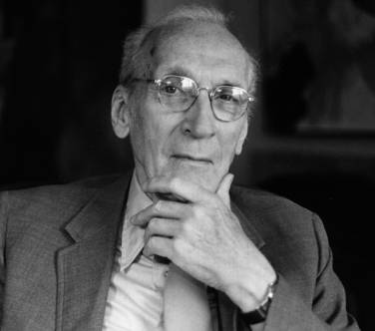
Is the Servant Leader Approach a Model for the Roles of Lawyers?
The servant-leader is servant first. It begins with the natural feeling that one wants to serve, to serve first. Then conscious choice brings one to aspire to lead.
(This) is sharply different from the person who is leader first … For this person it will be a later choice to serve (if this choice is made at all), after leadership
is established ...”
Robert K. Greenleaf, The Servant as Leader

Slide 8
Five Practices of Leadership Identified by Kouzes and Posner
Modeling the way
Clarify values by finding your voice and affirming shared ideals.
Set the example by aligning actions with shared values.
Inspiring a shared vision
Envision the future by imagining exciting and ennobling possibilities.
Enlist others in a common vision by appealing to shared aspirations.
Challenging the process
Search for opportunities by seizing the initiative and by looking outward for innovative ways to improve.
Experiment and take risks by constantly generating small wins and learning from experience.
Empowering others
Foster collaboration by building trust and facilitating relationships.
Strengthen others by increasing self- determination and developing competence.
Encouraging the heart
Recognize contributions by showing appreciation for individual excellence.
Celebrate the values and victories by creating a spirit of community.

Slide 9
Leadership Has Many Directions-Not Just From the Top
Leading from a position of authority
Leading from the side
Leading from below
Leadership with peers
How do lawyers lead when they serve clients and organizations?
How do young lawyers lead when they are in subordinate positions?

Slide 10
A Leadership Model for Lawyers
Who is the client (and the other parties)?
What are the goals and values of the client (and the other parties)?
What do we know and need to know?
What are the options, risk and consequences?
How should a decision be made, communicated and implemented?
What have we learned?

Slide 11
Leadership and Professional Identity Who Owns Your Reputation?
Who You Are
What Works
Canons of Ethics, Statutes and Court Rules

Slide 12
Balancing the Roles of a Lawyer Requires Leadership
Officer of
the Court
Advocate
Identity
Self Interest

