Slide 1
16th Annual Northern California ADR Faculty Conference Santa Clara University School of Law, February 27, 2016 ------ooooo-------
USING CONTROVERSIAL ISSUES IN ARBITRATION LAW TO ENGAGE ADR STUDENTS
------ooooo-------
Presented By Edward Lozowicki
Arbitrator & Mediator
www.lozowickiADR.com

Slide 2
1. Class Action Waivers and Arbitration
The FAA pre-empts a state law which invalidated class action waiver agreements coupled with an arbitration clause in a consumer adhesion contract. AT&T Mobility LLC v. Concepcion, 131 S.Ct. 1740 (2011)(5-4).
The FAA does not permit courts to invalidate a contractual waiver of class arbitration on the ground that the plaintiff’s cost of individual arbitration exceeds the potential recovery. The “effective vindication” doctrine does not invalidate the arbitration agreement. American Express Co. v. Italian Colors Restaurant, 133 S. Ct. 2304 (2013)(5-3).

Slide 3
1. Class Action Waivers and Arbitration
State court’s interpretation of contractual choice of law clause to invalidate an arbitration agreement does not put arbitration agreements on equal footing with all other contracts and does not comport with federal policy favoring arbitration and therefor the interpretation is preempted by the FAA. Direct TV Inc. v Imburgia, et al., SCOTUS No. 14-462, Dec. 14, 2015 (6-3).
However an arbitrator may employ class procedures if the arbitration clause authorizes them and an arbitrator’s decision to do so will not be vacated under §10(a)(4) of the FAA. Oxford Health Plans LLC v. Sutter, 133 S. Ct. 2064 (2013).

Slide 4
2. Impact on Consumer Contracts
What types of consumer contracts combine class action waivers with arbitration agreements?
Do such contracts allow consumers to opt out of arbitration?
E.G. Master Card Credit Card Agreement
E.G. Macy’s Credit Card Agreement
E.G. Hertz Rental Car Agreement

Slide 5
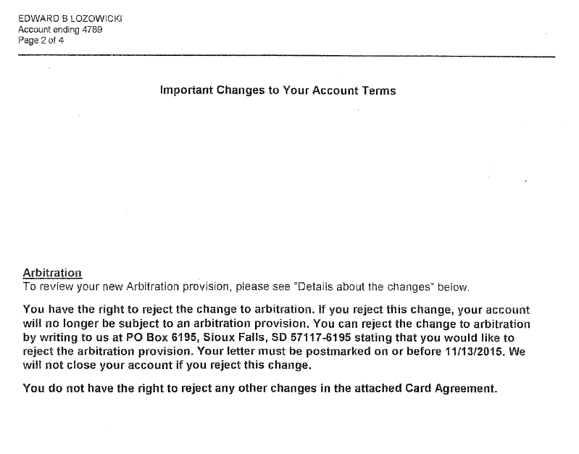
2. Impact on Consumer Contracts – Master Card

Slide 6
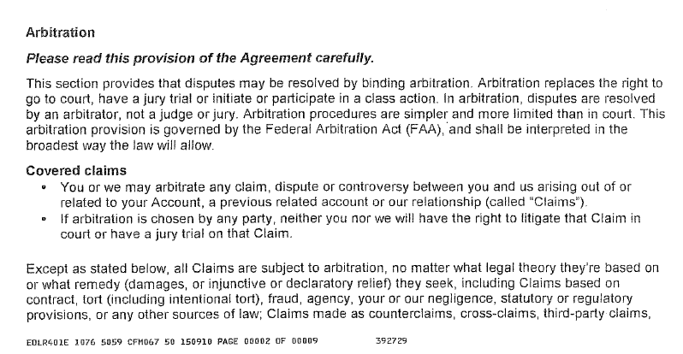
2. Impact on Consumer Contracts – Master Card

Slide 7
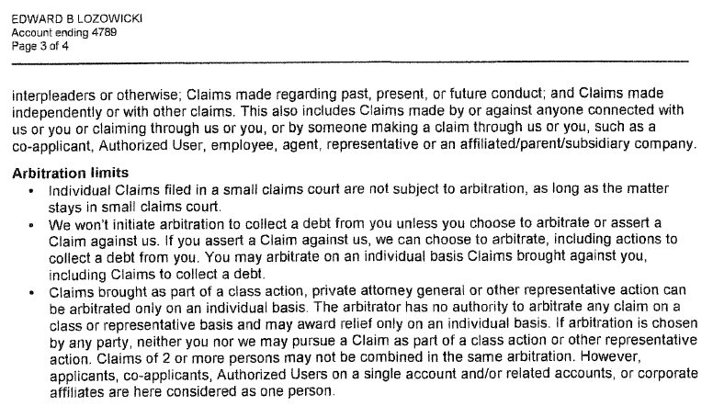
2. Impact on Consumer Contracts – Master Card

Slide 8
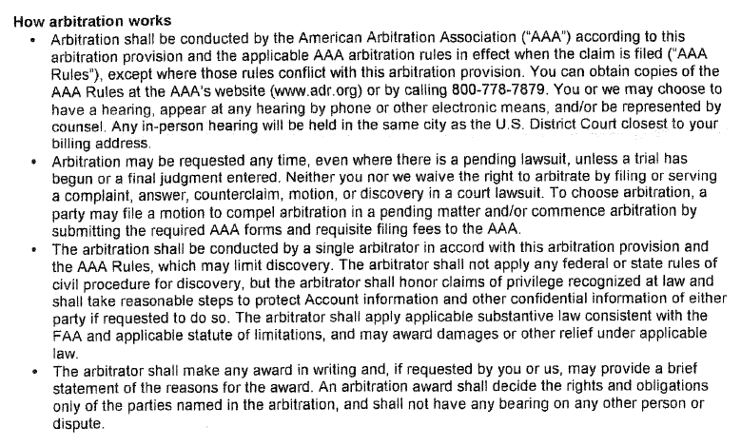
2. Impact on Consumer Contracts – Master Card

Slide 9
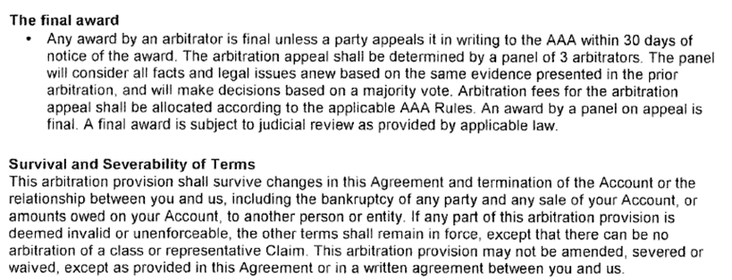
2. Impact on Consumer Contracts – Master Card

Slide 10
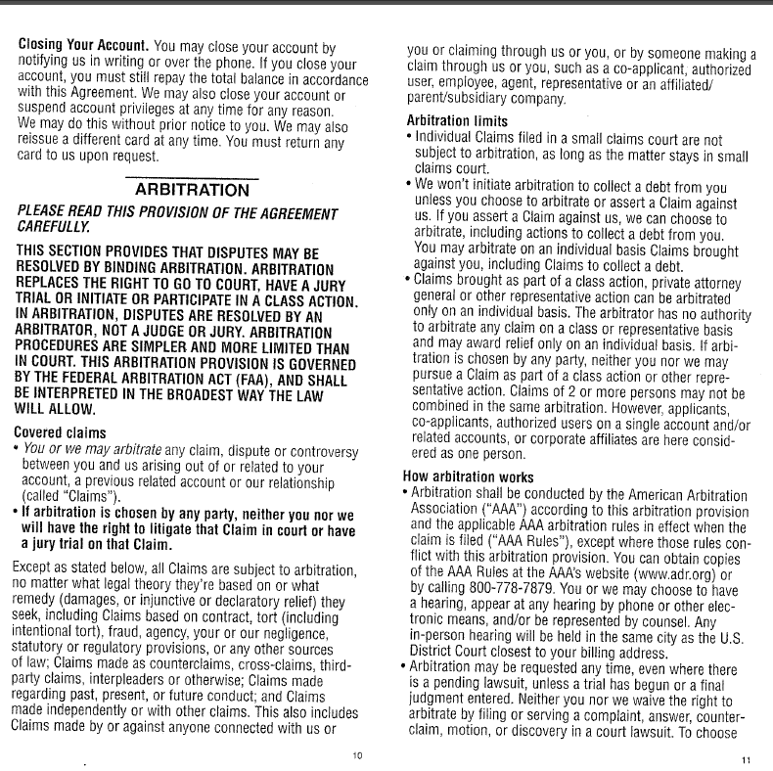
2. Impact on Consumer Contracts – Macy’s

Slide 11
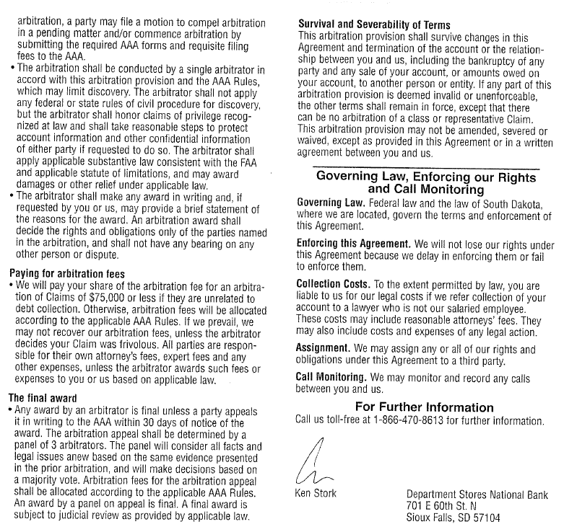
2. Impact on Consumer Contracts – Macy’s

Slide 12
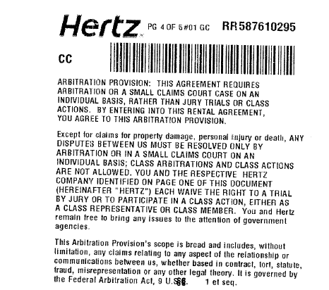
2. Impact on Consumer Contracts - Hertz

Slide 13
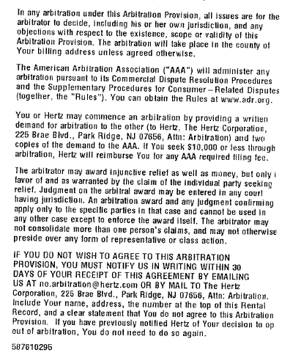
2. Impact on Consumer Contracts - Hertz

Slide 14
3. The Controversy
The Consumer Financial Protection Bureau is considering proposing regulations barring the use of arbitration clauses which contain class action waivers in contracts issued by financial institutions.
Consumer groups are campaigning for similar prohibitions in employment agreements. See, e.g. Assembly Bill 465 (would have prohibited any waiver of rights under the Labor Code in an arbitration agreement) which passed the California Legislature but was vetoed by the Governor.
See also the recent series of articles in the New York Times regarding “forced arbitration”.

Slide 15
4. Teaching Methods
Show students examples of impact of recent SCOTUS decisions on drafting of consumer contracts.
Call on students in class to defend both the majority and dissenters’ opinion in close cases.
Assign topics from SCOTUS decisions for student papers.

Slide 16
5. Determination of Arbitrability: Court or Arbitrator?
The U.S. Supreme Court seems to distinguish the issue of: 1) whether the parties have made an agreement to arbitrate; from 2) the issue of whether or not the arbitration agreement is valid or enforceable.
If the issue is the existence of a mutual agreement to arbitrate, then the Court must decide whether the parties have agreed to arbitrate unless there is a “clear and unmistakable intent” to submit that issue to the arbitrator. First Options of Chicago Inc. v. Kaplan, 514 U.S. 938 (1995) (court must decide if individual owners of company which agreed to arbitrate are also bound to arbitrate).

Slide 17
5. Determination of Arbitrability: Court or Arbitrator?
However, if the parties expressly agreed to submit the issue of enforceability of the arbitration agreement to the arbitrator then the issue will be decided by the arbitrator. Rent-A-Center West, Inc. v. Jackson, 130 S.Ct. 2772 (2010) (5-4) (delegation to arbitrator of enforceability issue in arbitration agreement is sustained despite claim that agreement is unconscionable under state law.)
Compare with Buckeye Check Cashing Inc. v. Cardegna, 546 U.S. 440 (2006) (claim that contract as a whole is void in that alleged usurious interest rates violate state law is issue for the arbitrator, not Court).

Slide 18
6. Impact on Consumer Contracts
Do consumer contracts delegate the issues of the existence and enforceability of the arbitration agreement to the court or to the arbitrator?
E.G. Many arbitration provisions in consumer contracts incorporate the rules of the American Arbitration Association.
American Arbitration Association Commercial Rule R-7 provides:
“(a) The arbitrator shall have the power to rule on his or her own jurisdiction, including any objections with respect to the existence, scope or validity of the arbitration agreement or to the arbitrability of any claim or counterclaim.

Slide 19
6. Impact on Consumer Contracts
(b) The arbitrator shall have the power to determine the existence or validity of a contract of which an arbitration clause forms a part. Such an arbitration clause shall be treated as an agreement independent of the other terms of the contract. A decision by the arbitrator that the contract is null and void shall not for that reason alone render invalid the arbitration clause.”
E.G. JAMS Comprehensive Arbitration Rule R-11(b) is similar.

Slide 20
7. Teaching Methods
Show students examples of the AAA and JAMS Rules.
Ask students to defend both the majority and dissenting opinions in the Jackson case.
Assign topics from SCOTUS arbitrability decisions for student papers.

Slide 21
8. Questions
474592940v1

