Slide 1
A View from the Dean of Students office: Can we Develop Leadership without Wellbeing?
Friday, March 23, 2018
Santa Clara Law Leadership Roundtable
Santa Clara, CA

Slide 2
An Evolving Student Pipeline
Accommodations
Generational Resilience Challenges
Sub-populations Face
Additional Challenges
Distracted, Over-Scheduled
Notes:
Educating an evolving population of students
Accommodation requests have increased over 50% in the last 2-3 years. Greatest increase is in accommodations related to mental health issues.
Generational resilience challenges, helicopter parenting,
Sub-populations face imposter syndrome, stereotype threat

Slide 3
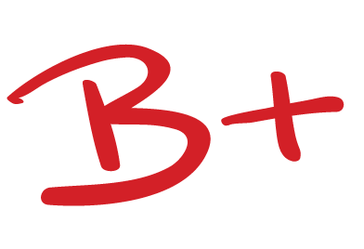
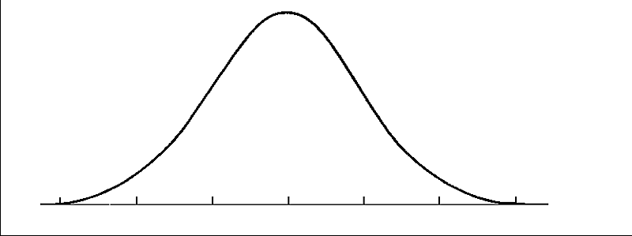
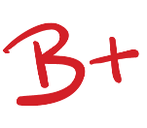
Law School Assaults Identity
Traditional Pedagogy, Competitive Evaluation System
Myopic Narrative of Success
Lack of Diverse Faculty, Mentors
Disconnection from family, friends
Notes:
As well documented by Larry Krieger, Kennon Sheldon, Elizabeth Mertz and others, law school can dramatically affect students’ wellbeing
Pedagogy
Focus on technical and textual concerns, with little or no mention of social, policy or substantive justice concerns
Permits and even rewards isolation
Often ignores individualism, humanity and emotion
Lack of feedback
Evaluation
Strict grade curves
Lack of feedback
Perceived arbitrariness
A population that hasn’t failed before
Myopic view of what should be rewarded
Success
Exacerbated by mythologized career paths
celebrations of warfare and antagonism
Narrow band of skills celebrated
Lack of Diverse Faculty
Disconnection from family, friends

Slide 4
External Factors Exacerbate the Problem
Debt loads
A still-challenging legal economy
Poisonous political environment
Law students struggle to talk openly

Slide 5
Is It Any Wonder …?
Depression
Anxiety
Suicidality
Problematic Drinking
Chronic Stress
Notes:
National Task Force on Lawyer Well-Being: ABA Commission on Lawyers Assistance Program, National Organization of Bar Counsel, Ass’n of Professional Responsibility Lawyers
As we have heard over the years at these roundtable events, the legal profession is at a critical moment of evolution, growth and change. Strong, vibrant, innovative leadership is needed to ensure lawyers continue to be a force for justice and making the world we live in a better place.
Krill study The Prev of Subst Abus and Other Mental Health Conc Among Amer Attys published in the journal of addiction medicine. 12,825 lawyers responded. Confirmed a troubling picture of the legal profession, from 21% of those who answered all AUDIT questions (versus 11.8% of general educated workforce) to 36% of those who answered the first 3 questions qualify as problem drinkers, and that approximately 28 percent depression, 19 % anxiety,and 23% stress, respectively, 61% at some point in career – anxiety, 46% at some point in career -- depression
Law Student Survey of Wellbeing: 43% binge drinking once in the prior two weeks, 22% more than once. Over 1/3 screened for anxiety – higher than other populations. Law students appear to be drinking more than they did 20 years ago.
Lawyers have highest incidence of major depressive disorder of 104 occupations
Prospective law students on par with population. After law school, symptoms are signficantly elevated.
NYT article, The Lawyer, the Addict. Last call was a conference call for work.

Slide 6
Pessimism Appears to Help!
1997 study at UVA Law showed that pessimism correlated to higher academic achievement.
Larry Richards’ research indicates that lawyers demonstrate strong skepticism and low resilience.
Notes:
Even more confounding, research has shown that a pessimistic explanatory style correlated with HIGHER academic performance for law students.
To sum up, they are anxious, depressed, drinking too much
They are conflicted and disconnected from their sense of self
They are loaded down by debt
And we have this concerning research showing that it might result in better grades
But other than that they are doing GREAT!

Slide 7
The Antidote …
Resilience
Growth Mindset
Self-Understanding
Strengths-Based Education
Energy Management
Relating to and Connecting with Others
Notes:
What can be done?
And it we don’t do anything, how can we expect them to model the way, encourage the heart or enable others?
It turns out the solutions are beautifully congruent with the foundational skills we are trying to encourage through leadership development. The things that make lawyers happy are many of the things that make them great leaders.
Larry Krieger and Kennon Sheldon found that autonomy (authenticity), relatedness to others, and competence are the strongest correlators to well-being and happiness
Undertaking action for the joy of it; Intrinsic factors (self-understanding, close relationships, helping others, building community lead to wellbeing)
Similarly, Marty Seligman and Chris Peterson, founders of positive psychology (study of traits, conditions that lead to thriving), found that happiness is highest when people experience pleasure, engagement and meaning.
Happiness (positive emotions) correlate to, and can result in higher productivity, higher pay, physical well-being, longer life,
Authenticity (or autonomy), connections/relatedness to others and competence are the foundations of great leaders.
So … we need them to develop core perspective-shifting skills in relation to themselves, so that they can do this with others
we need them to develop a stronger sense of self, so that they are authentic, credible and trustworthy in all that they do
(1)Build Coping, Flexibility and an ability to thrive in moments of stress, chaos, adversity through Resilience, Growth Mindset
a. Mindfulness
b. Perspective Shift (reflect on negative, self-defeating thinking patterns, identify more positive ways of viewing challenging situations); Pivoting (mental agility; broaden perspective, lengthen perspective, Petersons - Learned Optimism (but the law student emotional paradox)at 397-402. Broaden and Build theory. Positive emotions improves decision-making and cognitive flexibility. At 404. Builds intellectual, emotional and physical resilience and reduces stress and anxiety. At 404-05. Realistic Optimist (Harvard Negotiation Research Project); Dweck, nothing is insurmountable,
c. Gratitude at 394.
d. Cultivate compassion for themselves.
e. Manage Energy: Take Breaks, self-care
(2) Self-Understanding:
Identify and Use Positive Character Strengths (VIA; counter-response to DSM (diagnostic and statist manual of mental disorders)), Seligman and Peterson:
Identify and Use Positive Character Strengths
Wisdom & Knowledge: Creativity, Curiosity, Judgment, Love of Learning, Perspective
Courage: Bravery, Perserverance, Honesty, Zest
Humanity: Love, Kindness, Social Intelligence
Justice: Teamwork, Fairness, Leadership
Temperance: Forgiveness, Humility, Prudence, Self-Regulation
Transcendance: Appreciation of Beauty & Excellence, Gratitude, Hope, Humor, Spirituality
StrenthsFinder, Don Clifton

Slide 8
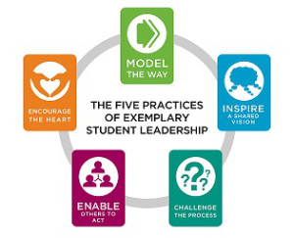
Curricular and Co-Curricular Partners in Leadership Development
First Year
RISE (resilience, optimizing performance, storytelling)
Orientation (Values exploration, resilience training, cultural competence, StrengthsFinder)
Week One Courses in emotional intelligence, leadership skills building
Lawyers in Balance
Second and Third Year
Experiential Curriculum
Throughout
Co-curricular programming: Law Student Mental Health Week (Turn It Around; Putting Positive Thinking in Practice); Mess or Mesh?

