Slide 1
Leading Law Schools:
Power, Persuasion & Progress
Michael T. Colatrella Jr.
Associate Dean of Academic Affairs & Professor of Law
McGeorge School of Law

Slide 2
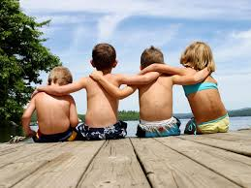
Leadership is a form of
Social Interaction

Slide 4
The choice of law school leadership
has become an existential decision
for many law schools.

Slide 6
“A Prince must not have any other object or any other thought, nor must he adopt anything as his art but war.”

Slide 7
“It’s better to be feared
than loved.”

Slide 8
Role of Leaders in
Educational Institutions
Inspire a shared vision
Enable others to act
Model the way
Kouszes & Posner 2012

Slide 9
Five Types of Leadership Power
Coercive
punishment for noncompliance
Reward
compensated for compliance
Legitimate
authority based on position in organization
Expert
skills and knowledge
Referent
trusted and respected
John French and Bertram Raven 1959

Slide 10
Types of Leadership Power
Expert
Referent
John French and Bertram Raven 1959

Slide 11
The purpose of law school is . . .
Education

Slide 12
Law school deans have very
little concrete power over
how law students are
educated.

Slide 13
“What are
you
prepared
to do?”

Slide 14
Example: Recipe for Superior Instruction
Communicate clear learning objectives
Deliver effective lessons through
modeling and guided practice
Check for understanding through
frequent formative assessment
Mike Schmoker, Focus 2011

Slide 15
Using hard power to force faculty to adopt certain policies is usually not to a dean’s advantage because it does not foster “psychological investment” in the initiative or policy.

Slide 16
The Key to Leadership in academia is the ability to influence

Slide 17
People not only matter in
educational organizations. . .
they matter the most.

Slide 18
Dacher Keltner, Ph.D
Professor, UC Berkeley

Slide 19
“Power is about making a
difference in the world by
influencing others.”

Slide 20
People are “empowered,”
not powerful.

Slide 21
Power comes from advancing others in the
social networks
Groups give power to those who advance
the greater good
Groups construct reputations that
determine the capacity to influence

Slide 22
Big Five Social
Tendencies of Leaders

Slide 23
Enthusiasm

Slide 24
Kindness

Slide 25
Focus on Group Goals

Slide 26
Calmness

Slide 27
Openness

Slide 29
Your career success depends significantly on how you interact with other people

Slide 30
Choice:
“Do we claim as much as we can,
or contribute value without
worrying about what we receive
in return?”
Grant, Give and Take 2013

Slide 31
Givers
"Pay more attention to what others need from them, then what they need."

Slide 32
Takers
Takers give strategically

Slide 33
Matchers
Try to maintain a balance between what they give and get

Slide 34
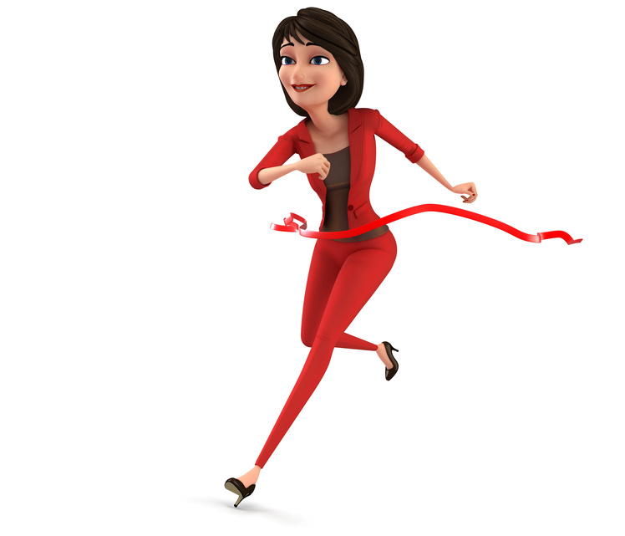
Givers
Succeed

Slide 35
Giving might include:
Enabling people to do good work
Mentoring
Sharing credit
Making connections for others
Expressing gratitude

Slide 36
The Give and Take Instrument
www.giveandtake.com

