Slide 1
LEADERSHIP DEVELOPMENT FOR LAW STUDENTS
Robert Cullen
BEYOND THEORY:
DEVELOPING AND INSPIRING OUR STUDENTS TO BE LEADERS

Slide 2
Bob Cullen
35 Year Legal Career- Lawyer- Managing Partner- Mediator- GC
Adjunct Professor- for 18 years at SCU.
Developed the first Law School Leadership Class in 2005 here at SCU.

Slide 3
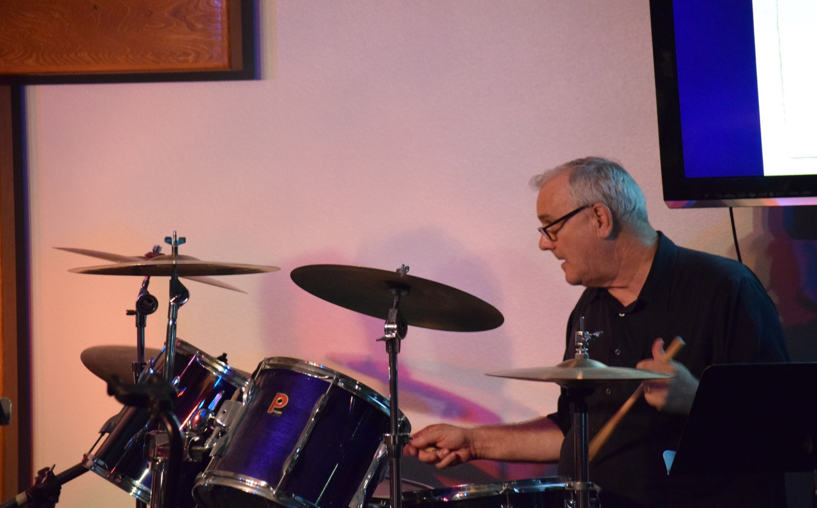
Missed out on my real career.

Slide 4
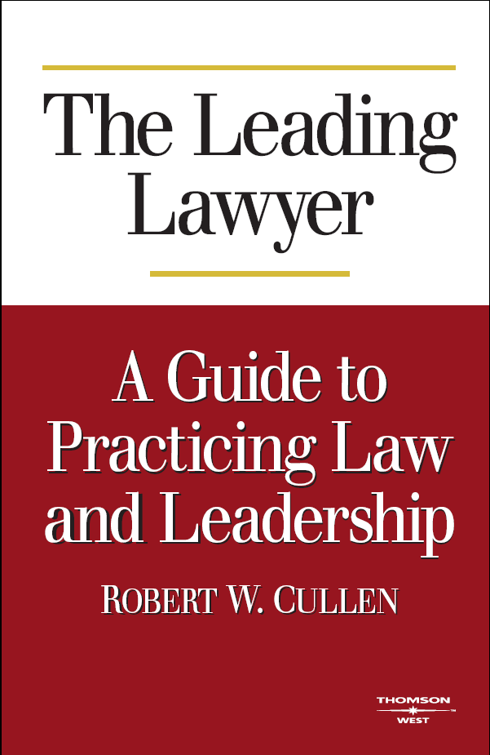
Wrote a Book in 2007

Slide 5
Ten Leading Lawyer Interviews
Leon Panetta
Ben Heineman
Ca. Supreme Ct. Justice Joyce Kennard
Larry Sonsini
Fred Krupp
Robert Grey
William Loris
Deputy Assistant Attorney General Deborah Garza
Elizabeth Cabraser
Rudy Giuliani

Slide 6
What Makes Some Lawyers Great?
They practice law and they practice leadership.
Successful lawyers have great legal skills; in addition, they incorporate leadership skills in their practice to create opportunities, build relationships and create positive change for their clients, their organizations, and their communities.
Leadership is an essential ingredient to an extraordinary career in law.
In short, extraordinary lawyers think like lawyers and think like leaders.

Slide 7
Working Definition of
Leadership for Lawyers
The process by which an individual or group influences others to achieve positive, ethical change.

Slide 8

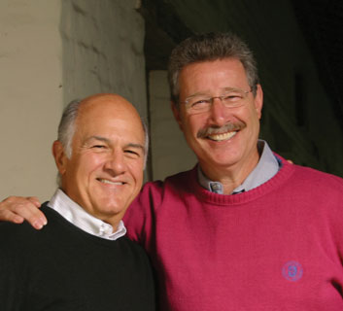
I started Teaching the Leadership Challenge Model
The Five Practices of Exemplary Leadership
Model the Way
Inspire a Shared Vision
Challenge the Process
Enable Others to Act
Encourage the Heart

Slide 9
A Focus on Skills and Training
Leadership is an identifiable set of skills and practices that are available to all of us, not just a few charismatic men and women. . . . It is the art of mobilizing others to want to struggle for shared aspirations. (Posner and Kouzes)
Leadership is for everyone.

Slide 10
CCL Leadership Progression
LEADING SELF | LEADING OTHERS | LEADING MANAGERS | LEADING THE FUNCTION | LEADING THE ORGANIZATION
• Prepare for leadership roles • Build a leadership identity • Increase personal effectiveness and performance | • Transition from individual performer to leading a team • Build relationships to get work done • Deal effectively with conflict • Solve problems successfully | • Integrate cross-functional perspectives in decisions • Handle complexity • Sell ideas to senior leaders • Select and lead managers for high performance | • Set vision and build toward the future • Balance trade-offs between the short-and long-term • Align the organization for strategy implementation | • Set organizational direction • Foster alignments across the organization • Gain commitment for performance • Refine and build strong executive persona
Our Students are Here

Slide 11
The first step in Leadership Development is Personal – it about the Individual- it is about our students learning why they might want to lead.
Our law students are in the early part of their careers- CCL calls this the “Leading Self” level; personal leadership development.
Self Assessment is a critical at this Level.
I use Lectures and a lot of Active and Experiential Learning Strategies.
They examine leadership ideas, values, skills and also explore: What and why should they lead?

Slide 12
Successful Leadership Development
Theory – Leadership Models- Policy and Literature
Self Assessment
Exercises
Skill Development
Break Out Sessions
Case Studies

Slide 13
Self Assessment Tools
Myers Briggs
Campbell Leadership Descriptor
Leadership Challenge Practices Inventory - LPI
Thomas Killman
University of Pennsylvania - Strengths Test - Skill Assessment- Character Strengths
Gallop – Clifton – Roth - Strengths Finder
Grit Survey- Angela Duckworth
I think a 360 would be interesting but expensive and a bit time consuming.

Slide 14
Module Topics
Introduction-Exercises-Case Studies
Vision.
Strategy and decision making.
Team work and collaboration.
Innovative, entrepreneurial and creative thinking.
Relationship building not breaking (Relationships are the foundation of Leadership).
How to build credibility.
Influence, persuasion and communication.
Emotional awareness and IQ.
Cultural awareness.
Grit and a Growth Mindset.

Slide 15
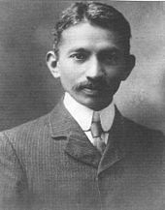
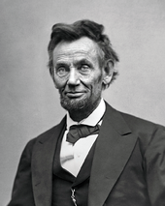
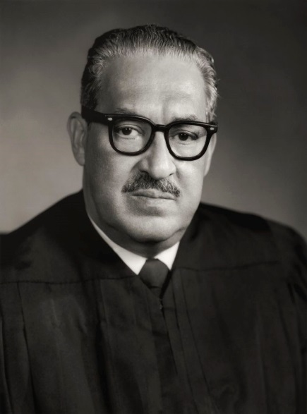

Case Studies
Gandhi
Lincoln
Thurgood Marshall
HBS Case Studies

Slide 16
The Leadership Challenge
The Five Practices of Exemplary Leadership
Model the Way
Inspire a Shared Vision
Challenge the Process
Enable Others to Act
Encourage the Heart
After 10 Years- it is all about Encouraging the Heart

Slide 17
In this New Normal: A Super Competitive Legal Environment and the Gig Economy.
My Goals
To give my students legal and career success skills (I now think entrepreneurial skills are critical).
To let them explore and create their leadership values and character.
To have them (start to) create a vision and purpose for their legal career.
To help them understand their interests, character traits, strengths and have them further develop their professional and leadership identity.
To inspire and empower them to make positive change for themselves, for their communities and organizations.

Slide 18
Working Definition of
Leadership for Lawyers
The process by which an individual or group influences others to achieve positive, ethical change.

Slide 19
When does one lead?
When something is important enough for them to change.
Leadership is the result of knowing what is important to you, wanting to create meaningful change, and taking the action to create such change.
It could be a change in you, your family, your job, your school, your environment, in your community or society.
You will want to lead- when something important to you needs change.
So what is important to you?

Slide 20
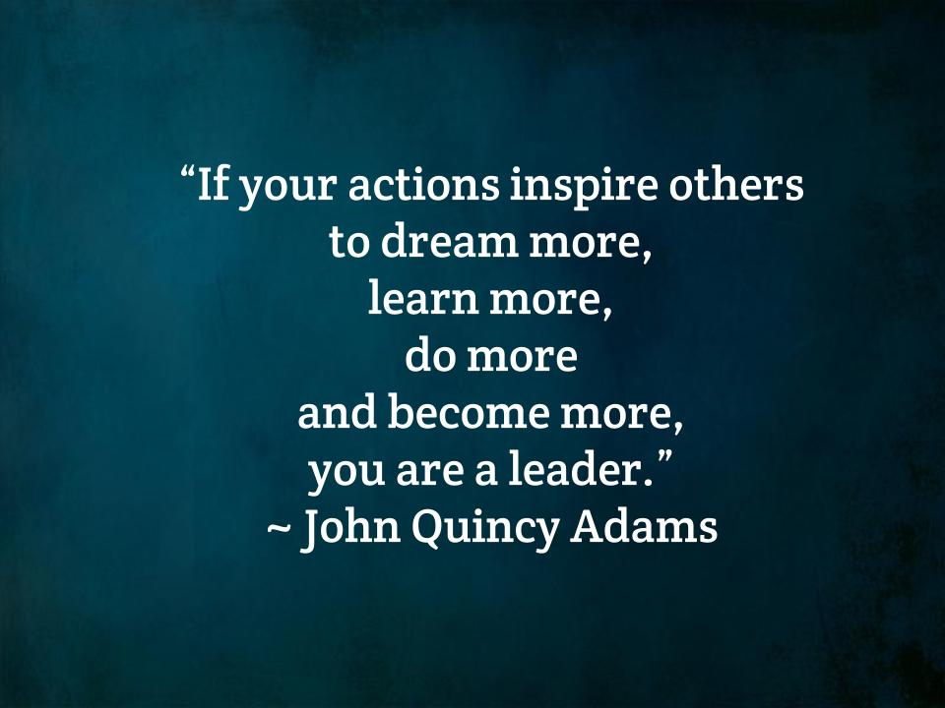
Here is what is important to me.

Slide 21
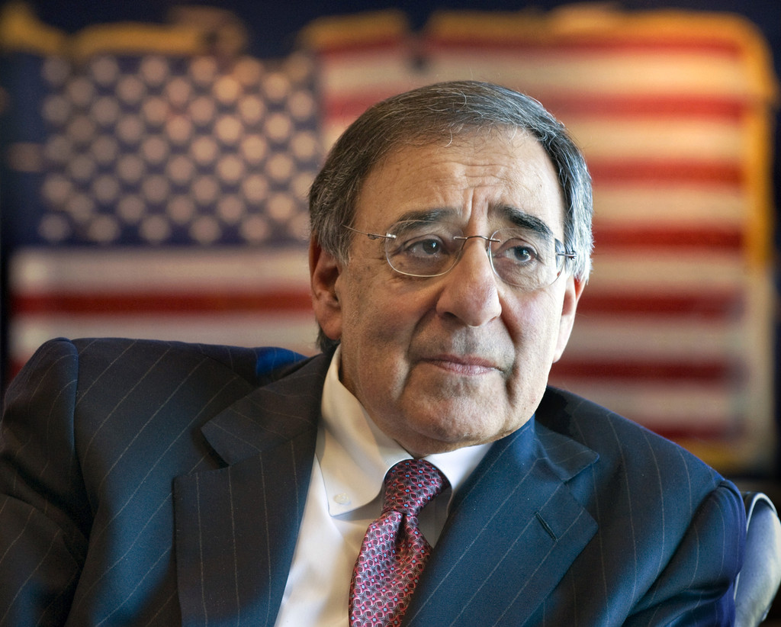
Leon Panetta
As lawyers, you’re getting a license, not only to practice law, your getting a license to be a leader.
Leon Panetta
SCU Law Graduate 1963

